Slide 1

Matrix Generation
Anna Ricker

Slide 2
What we need:
Large collection of matrices
Regular matrices
Lightly occupied matrices
Notes:
It is not important, that every detail is choosen by the user -> BUT it is important to have matrix close to matrices representing real world problems

Slide 3
LAPACK
Offers a random matrix generator, that was developed to generate matrices to test large numerical linear algebra libraries.
xLATMR
xLATMS
xLATMe
Notes:
It was hard to find specific types of real world matrices
Thats why the generator is strongly oriented on LAPACK
Offers random matrix generator, developed to test large numerical algebra libraries
x is either `S', `D', `C', or `Z‘ (single/double precision real/complex
Complex is beyond the scope of our work

Slide 4
Diagonal Entries by LAPACK
Input by the user.
D(1) = 1 and the other D(i) = $\frac{1}{COND}$
D(1) = 1 and the other D(i) = 1/𝐶𝑂𝑁𝐷
D(N) = $\frac{1}{COND}$ and the other D(i) = 1.
D(N) = 1/𝐶𝑂𝑁𝐷 and the other D(i) = 1.
The D(i) form a geometric sequence from 1 to $\frac{1}{ COND}$.
The D(i) form a geometric sequence from 1 to 1/( 𝐶𝑂𝑁𝐷).
Notes:
In all 3 different cases first of all the diagonal entries are determined. For that the user can choose from 7 different options
COND is set by the user; COND >= 1
Where N is the size of the matrix

Slide 5
Diagonal Entries by LAPACK
The D(i) form an arithmetic sequence from 1 to $\frac{1}{COND}$
The D(i) form an arithmetic sequence from 1 to 1/𝐶𝑂𝑁𝐷
The D(i) are random in the range [$\frac{1}{COND};$1] with uniformly distributed logarithms.
The D(i) are random in the range [1/𝐶𝑂𝑁𝐷;1] with uniformly distributed logarithms.
The D(i) are random with the same distribution as the other matrix entries.
Notes:
value = value * 1/self.cond
value = value + 1/self.cond

Slide 6
Generation by xLATMR
Pre-/postmultiply by Diagonalmatrices
Permute rows and collums
Set random entries of A to zero
Make A a band matrix
Notes:
Given: Matrix with random values in a given distribution and diagonalvalues as explained before
Make A a band matrix, if desired, by zeroing out its entries outside given upper and lower bandwidths.

Slide 7
Generation by xLATMS
Pre- and postmultiply by Orthogonal matrices
Reduce the bandwidth of A with householder transformation
Notes:
Given: Diagonalmatrix with values as explained before
Pre and postmultiplying by Orthogonal matrices (if A schould be symmetric premultiply with the transpose of the postmultiplying one)

Slide 8
Generation by xLATME
Fill the upper triangle
Pre/posmultiply with S and S⁻¹
Reducing upper OR lower bandwith
Notes:
Given: Diagonalmatrix with values as explained before
Pre/posmultiply with S and S⁻¹ (S is a random dense nonsymmetric matrix; you can generate S with Diagonalentries described before)

Slide 9
Distribution
Uniform distibution on (0 , 1)
Uniform distribution on (-1, 1)
Normal distribution on (0, 1)

Slide 10
Density
Idea:
x = density * number of matrix entries
Set random entries of A to zero (x times)
Notes:
Calculate a value x
The value density should be a value between 0 and 1
To guarantee that the main diagonal entries will not be zero, the diagonal entries will be set after spreading zeros to lower the density.

Slide 11
Idea: multiple Strategies
Set Diagonalentries
Randomly choose one of the 6 following Options

Slide 12
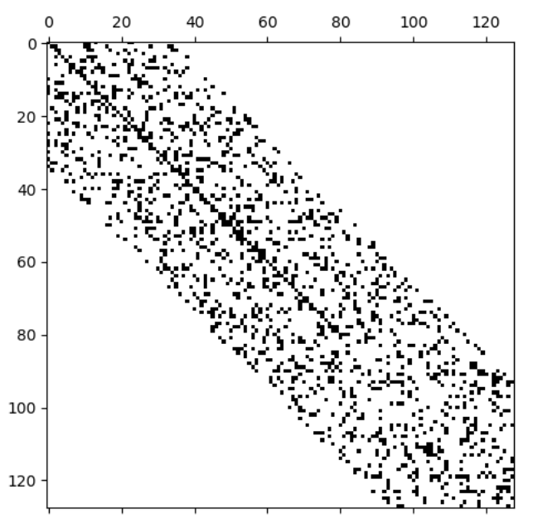
Generator 1
Pre-/ Postmultiplying by Orthogonalmatrices
Reduce the Matrix with Housholder transformation
Notes:
based on xLATMS:
Householder:
Using QR decomposition, different parts of matrix A are pre and postmultiplied by Q and QT multiple times.

Slide 13
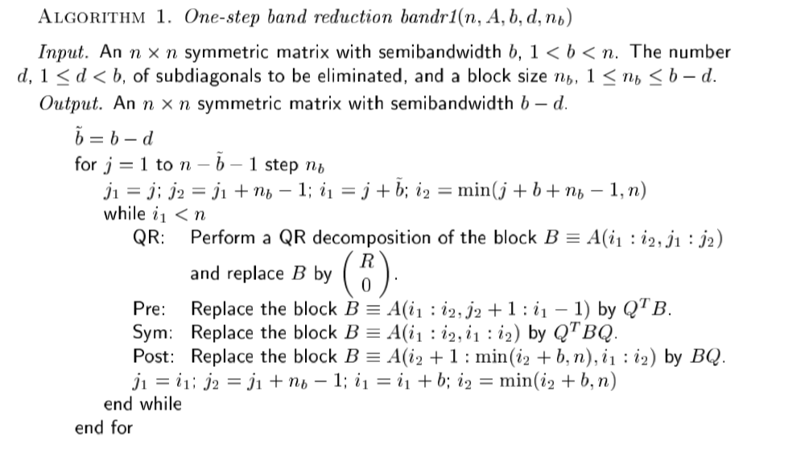

Slide 14
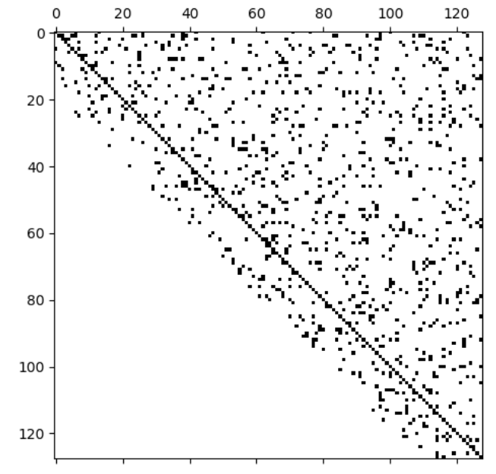
Generator 2
Fill upper/ lower Triangle
(optional) Pre-/ Postmultiply with S and S⁻¹
(optional) Reducing upper OR lower bandwith
(optional) Set density
Notes:
based on xLATME
Set the diagonal first

Slide 15
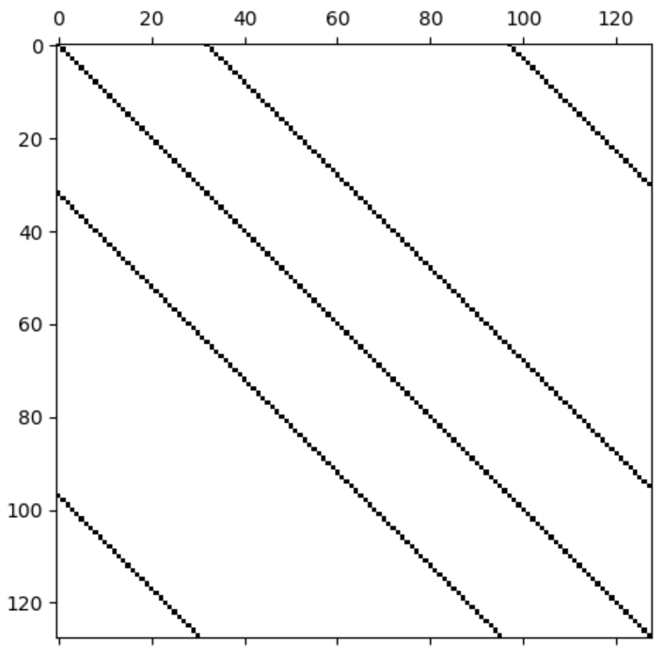
Generator 3
Set the Diagonal entries as defined by LAPACK
Set a random number of side diagonals
A distance value will be randomly set
Both diagonals with the given random distance will be filled with random entries
Notes:
-Set a random number of side diagonals (Range can be variable):-
-A distance value will be randomly set (between 1 and N-1)
-Both diagonals (upper and lower) with the given random distance will be filled with random entries

Slide 16
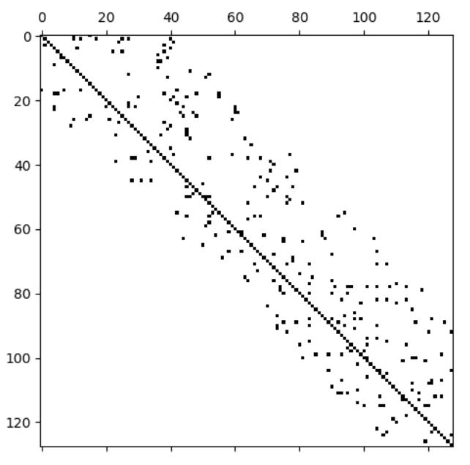
Generator 4
Generate a matrix with total random entries
(optional) Pre-/Post multiply by diagonal matrices
(optional) Permute rows/columns
(optional) Set density
(optional) Reduce upper OR lower bandwidth

Slide 17
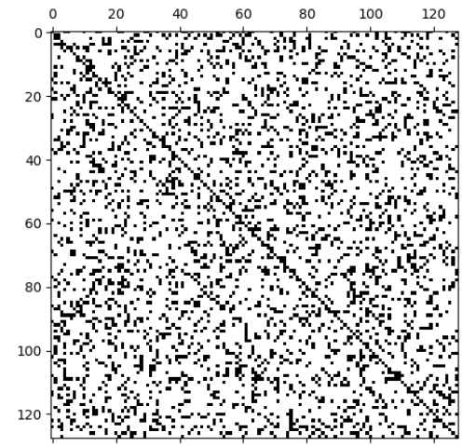
Generator 5
Generate a matrix with total random entries
orthogonalised by Gram-Schmidt
Notes:
When setting density

Slide 18
Generating positive definite matrices
positive definite is similarity invariant
pre and post multiplying a positive definite matrix with S and S⁻¹ ensures that the return matrix is positive definite too
Notes:
another interesting characteristic of a matrix for this use case:
Generator 6 is the only one who can guarantee to be positive definit

Slide 19
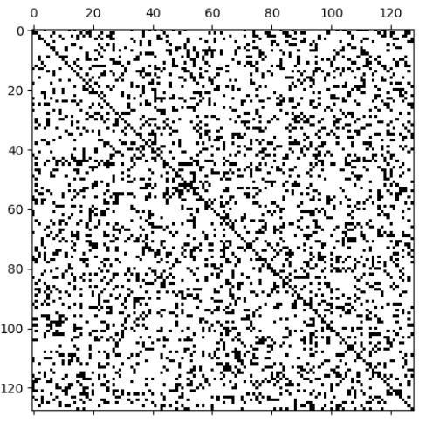
Generator 6
Generate a diagonal matrix with just positive entries
Pre and post multiply by S and S⁻¹
Notes:
Guarantees positive definite matrices
When setting density, matrix is not positiv definit anymore

Slide 20
Regularity in matrix generation
Generator 1 and 5 can fully guarantee regularity
Generator 2 and 4 can not fully guarantee regularity
Generator 3 never showed a case of irregularity
Notes:
1+5: orthogonal matrices are always regular; if density is set, regularity is not guaranteed
2+4: because of the bandwidth reducing and the increasing of zero values to lower the density; both steps do not necessarily ensure the matrix will loose its regularity
3: as long as density is not set!!

Slide 21
Conclusion

